Slide 1
Sales forecast for video games using google trends
Team: Anshika, Pratish, Sanchita, Karthik, Akshay, Rounak

Slide 2
Problem Statement
We will be analyzing and visualizing user’s interests across various fields on the
basis of past 5 years data trends. We have taken video games ,Xbox and Play
station 4 as a technology product for doing the sales forecast for North America
and comparing those sales to Europe and Japan.
So, basically we will be predicting which product is searched and sold the most?

Slide 3
Data -Pipeline
Data visualization i.e. insights
Frame work using
power bi
Extracted data from Kaggle and google trends from google
1
3
5
2
4
6
Transformation i.e. data pre-processing
Frame work using stream lit
Deployed on GitHub

Slide 4
Attributes
GAMES
YEAR OF RELEASE
GENRE, PUBLISHER
NA,JP,EU -SALES
OTHER SALES
GLOBAL SALES

Slide 5
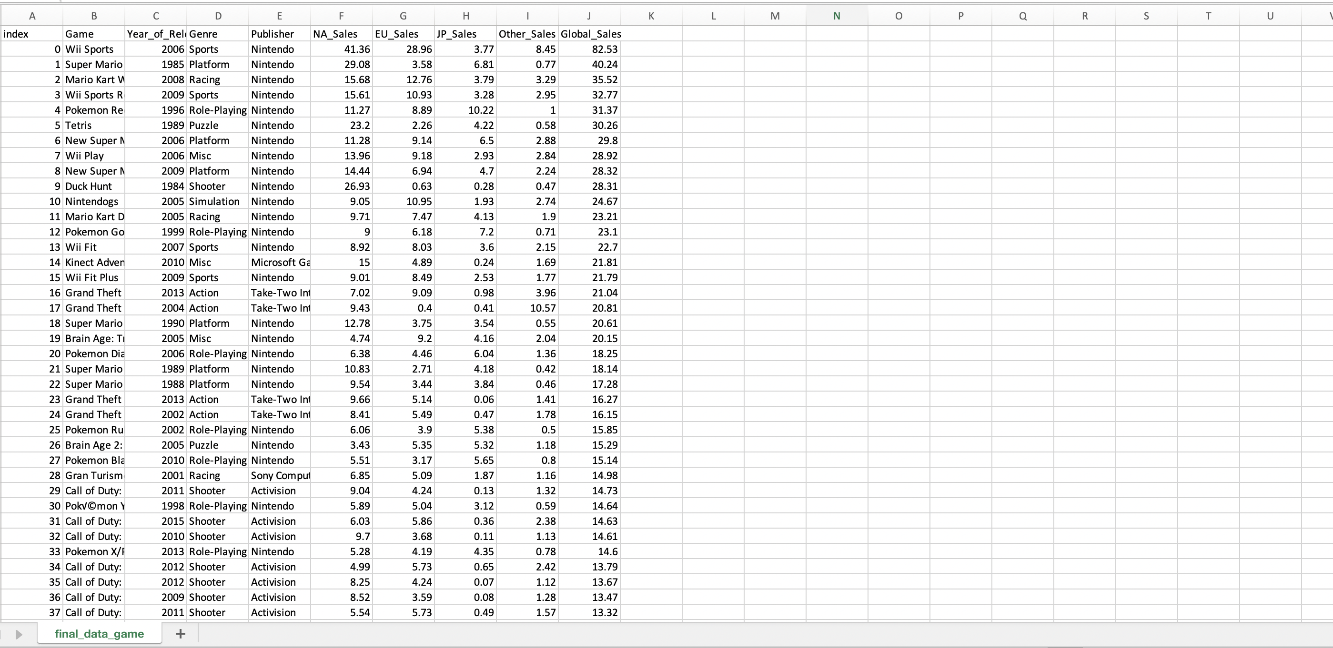
Final Data-set

Slide 6
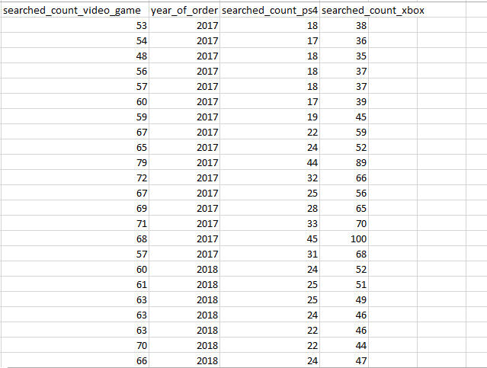
Google-Trend Dataset

Slide 7
Stream-lit Application

Slide 8
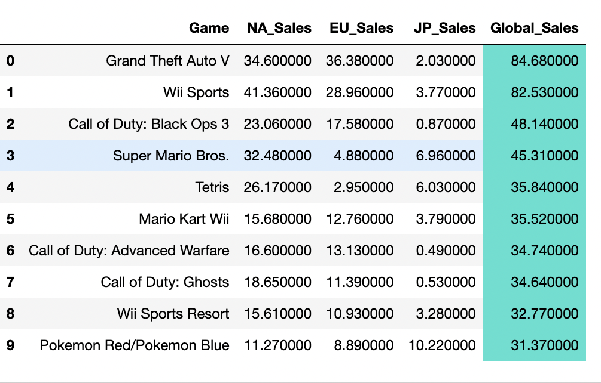
Most successful game sales rates globally.

Slide 9
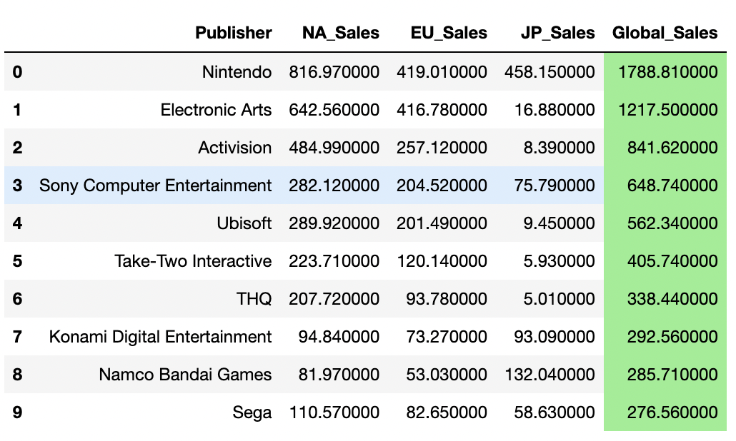
Most successful Companies

Slide 10
POWER-BI DASHBOARD
VIDEO GAMES TRENDS
XBOX-ONE TRENDS
DAILY TRENDS OF PAST 5 YEARS
PLAYSTATION 4 TRENDS

Slide 11
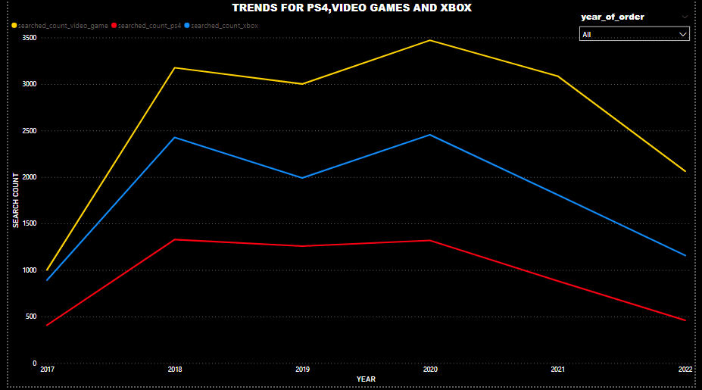

Slide 12
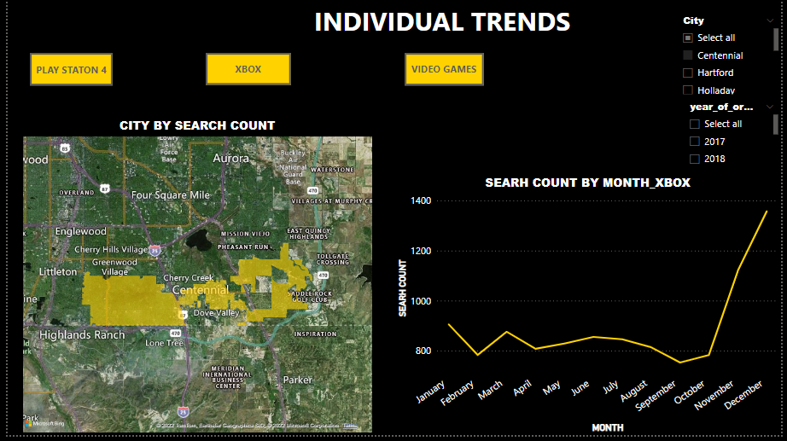

Slide 13
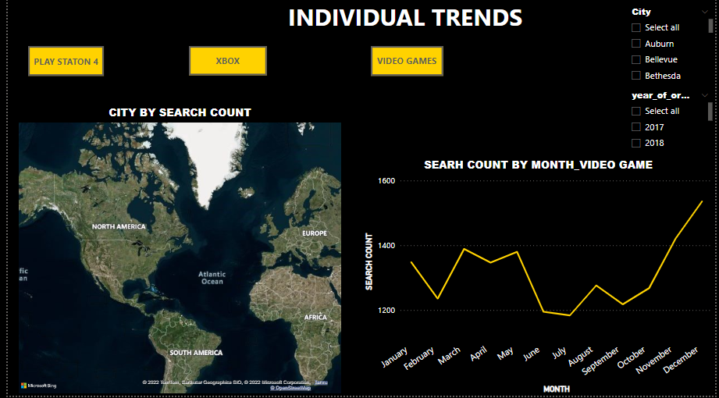

Slide 14
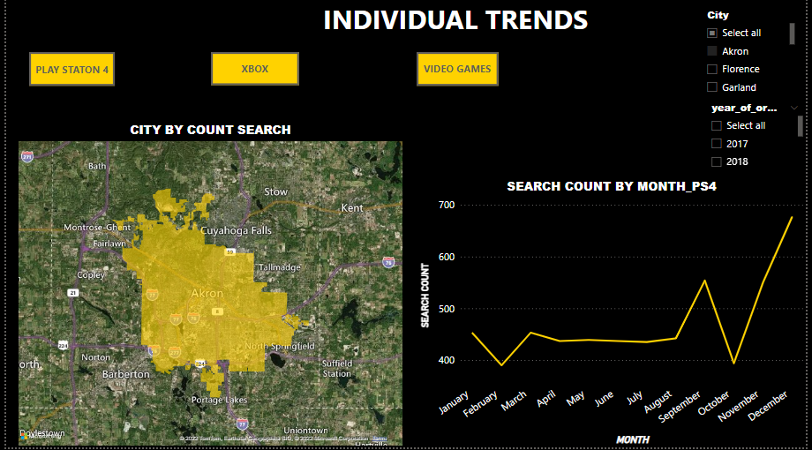

Slide 15
Future Scope & Conclusion
According to our analysis and prediction we have come to the conclusion that the findings obtained from the dashboard can help in improving customer services and experiences, thereby strengthening the relationship between the financial institution and it's customers.
The ps4 has the faster base system. Even if the Xbox one X is the most powerful console, this generation will be constrained by it’s lowest common denominator. This means, even though we have the PS4 pro and the Xbox one games still have to work on the basic versions of those systems. And in this gen, the PS4 has the better base system.

Slide 16
Links and References
Git-hub link: https://github.com/ansh27ika/Streamlit-app-for-video-game-analysis
Local host : http://localhost:8501/

Slide 17
Roles and Responsibilities
Names | Responsibilities
Anshika Aggarwal | Stream-lit application ,ppt, found Dataset , pre-processing for google trends
Karthik Raj | Data-cleaning for final dataset and stream-lit
Rounak Shankar | Problem statement and conclusion
Pratish S | Power bi dashboard , ppt
Akshay Madhukar Raut | Visualization of Insights
Sanchita Rajapure | Presentation

Slide 18
Thanks!
Any questions ?

